Slide 1




Time Series Forecasting model for Air Pollution in New York City
Team 6
Apoorva Prakash
Halleluya Mengesha
Hira Stanley

Slide 2

1. Problem Introduction
2. Data Source & Details
3. Exploratory Data Analysis
Contents
4. Time Series Forecasting Models
5. Supplementary Questions
6. Way Forward

Slide 3


Problem Statement
Manhattan, the smallest yet most densely populated borough of New York City, faces significant challenges in managing air pollution. Over the past two decades, pollution levels have fluctuated due to increased vehicle usage, emissions from aging building boilers, and changing weather patterns. Despite regulatory efforts, pollutants like PM 2.5, Ozone, and CO continue to pose environmental and public health risks.
Air pollution in Manhattan is primarily driven by:
Vehicle emissions from heavy traffic congestion.
Boiler pollutants (NOx, PM2.5, SO2) from heating systems in older buildings.
Weather conditions, which can either disperse or trap pollutants, affecting daily air quality levels.
How does the Air Quality Index (AQI) in Manhattan evolve over time, and what are its key drivers?
How do weather conditions affect AQI levels?

Slide 4
Data
Data Source
https://openweathermap.org/
Data Description
Data spans from January 01, 2000 – December 31, 2024 (25 years). This accounts for 9000+ rows in this dataset
Data includes 14 features - Date, AQI, Main Pollutant, Site Name, Site ID, Source, CO, Ozone, PM10, PM25, NO2, Temperature, Humidity, Wind Speed
Data Challenges
Limited Temporal Resolution – The first dataset we explored, despite offering more exogenous variables such as health and borough-level data, was biannual. This made it difficult to analyze trends and seasonality effectively, as only two data points per year were insufficient to capture meaningful fluctuations.

Slide 5
Exploratory Data Analysis

Slide 6
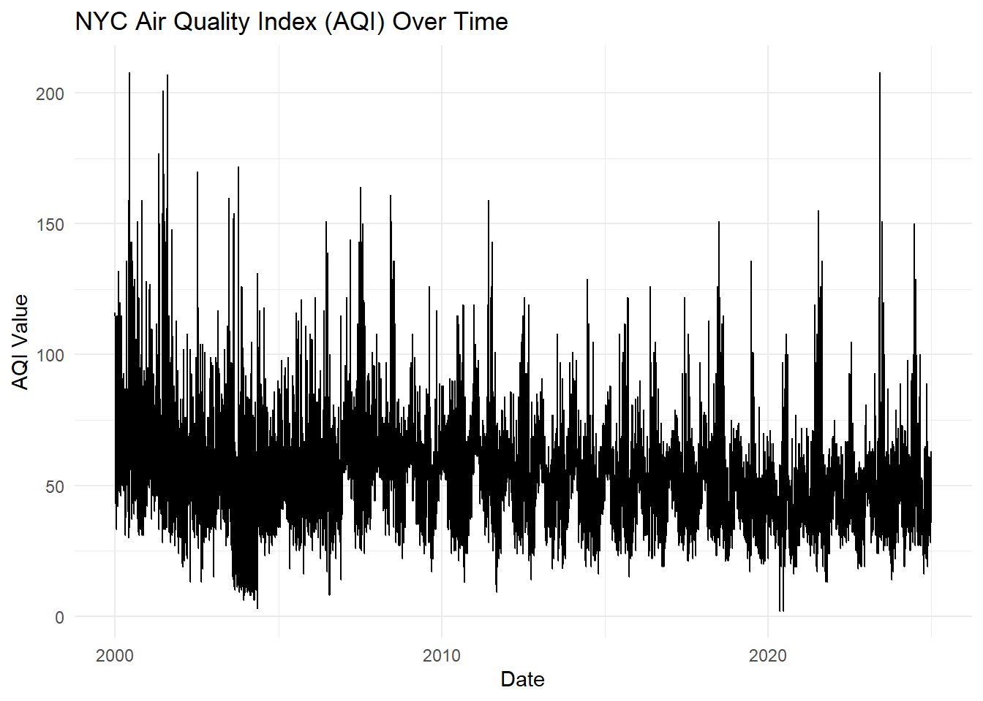
NYC Air Quality Index over time
Overall Declining Trend: The Air Quality Index (AQI) in NYC appears to show a decreasing trend over time, especially from the early 2000s to the present, suggesting an improvement in air quality.
High Variability: The AQI values exhibit significant fluctuations throughout the timeline, with frequent spikes indicating occasional periods of poor air quality.
Recent Stability: In the later years (post-2010), while the AQI still has variability, the extreme spikes appear to be less frequent compared to the earlier years. This may suggest better air quality control measures in place.

Slide 7
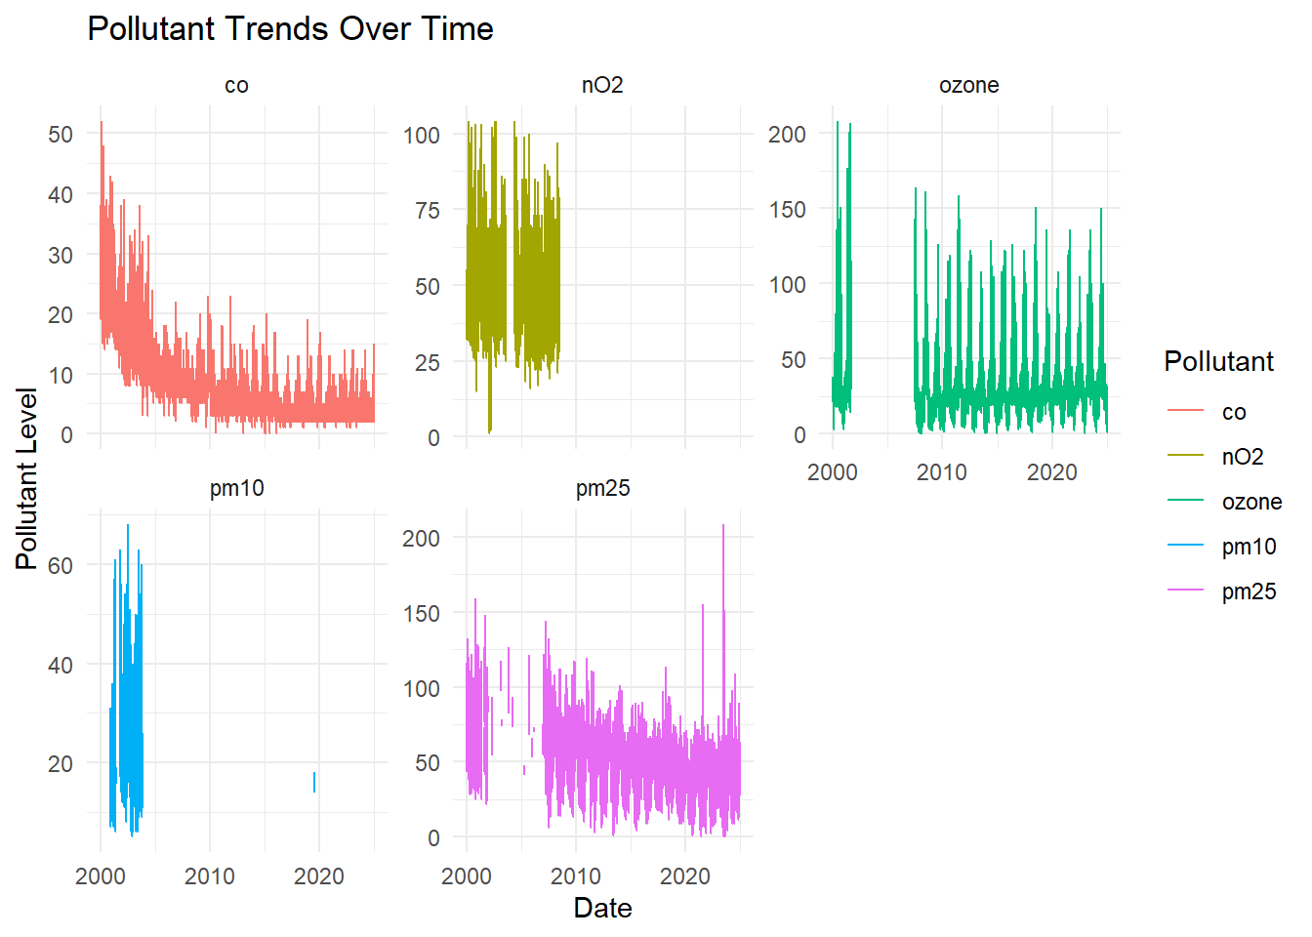
Individual Pollutant trends over time
Decrease in Carbon Monoxide (CO) Levels: The CO levels show a significant decline over time, indicating improved air quality measures and reduced emissions from sources like vehicles and industries.
Variability in Other Pollutants: While NO2, ozone, PM10, and PM2.5 show fluctuations, their trends are less clear. Ozone and PM2.5 appear to have persistent variations, with periodic spikes over time.
Data Gaps or Inconsistencies: Some pollutants, such as PM10 and NO2, show missing data for certain periods, which might indicate changes in data collection methods or sensor availability.

Slide 8
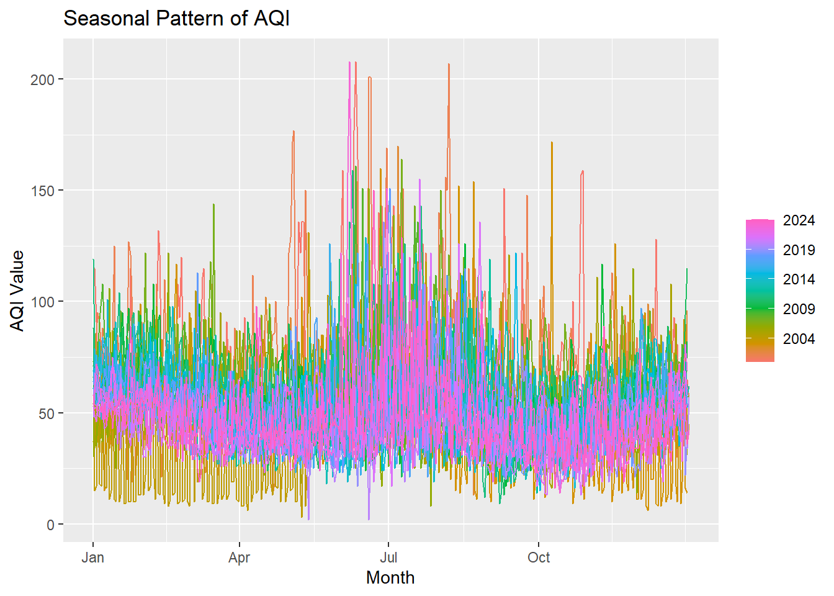
Seasonal Patterns in AQI
Seasonal Variation in AQI: The AQI values tend to be higher during the summer months (June–August), suggesting that air quality worsens during this period, possibly due to increased ozone formation and stagnant air conditions.
Yearly Patterns Are Similar: Despite fluctuations, the general seasonal pattern remains consistent across different years, indicating recurring environmental or meteorological factors influencing AQI.
More Recent Years Show Higher Peaks: The years between 2019 and 2024 (represented by blue to pink) show slightly higher AQI spikes compared to older years like 2004 (orange), which may indicate increasing pollution sources or more extreme weather conditions affecting air quality.

Slide 9
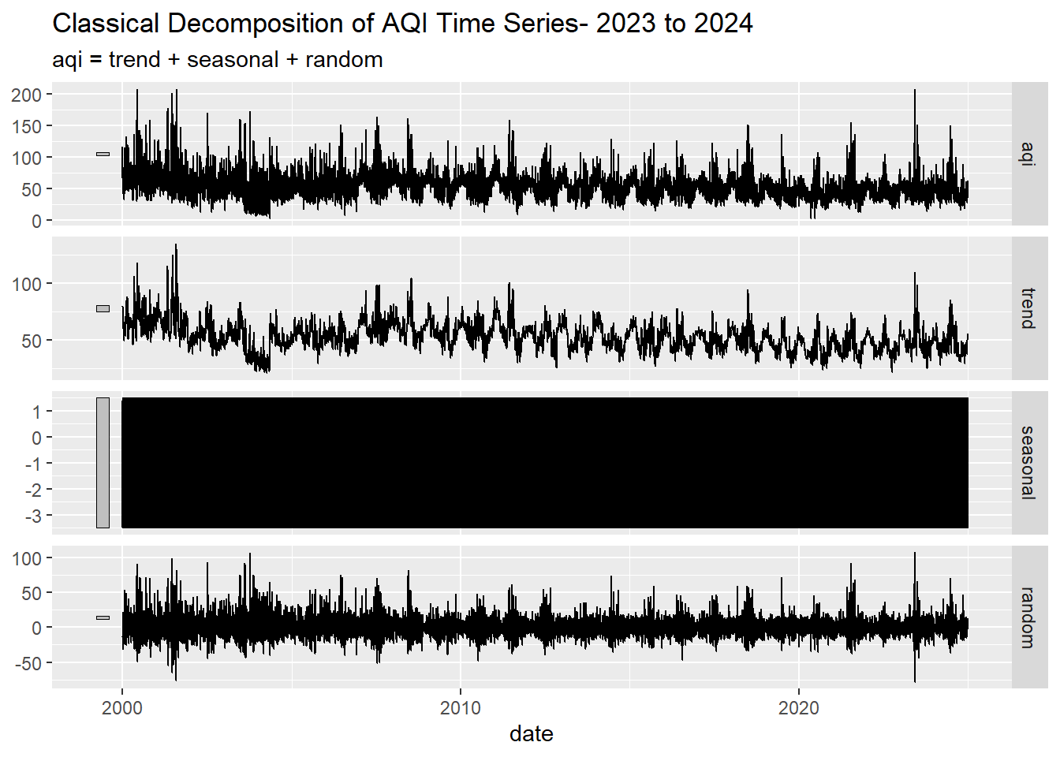
Classical Decomposition of AQI Time Series (2023–2024)
Trend
The trend shows a generally stable pattern with some fluctuations, indicating that there is no clear upward or downward movement in AQI levels over time.
Seasonality
The seasonal plot appears highly compressed and less interpretable, suggesting that the classical decomposition might not capture complex seasonal patterns effectively.
Random Noise
Significant variability in the random component implies that there are substantial short-term fluctuations or noise in the AQI data.

Slide 10
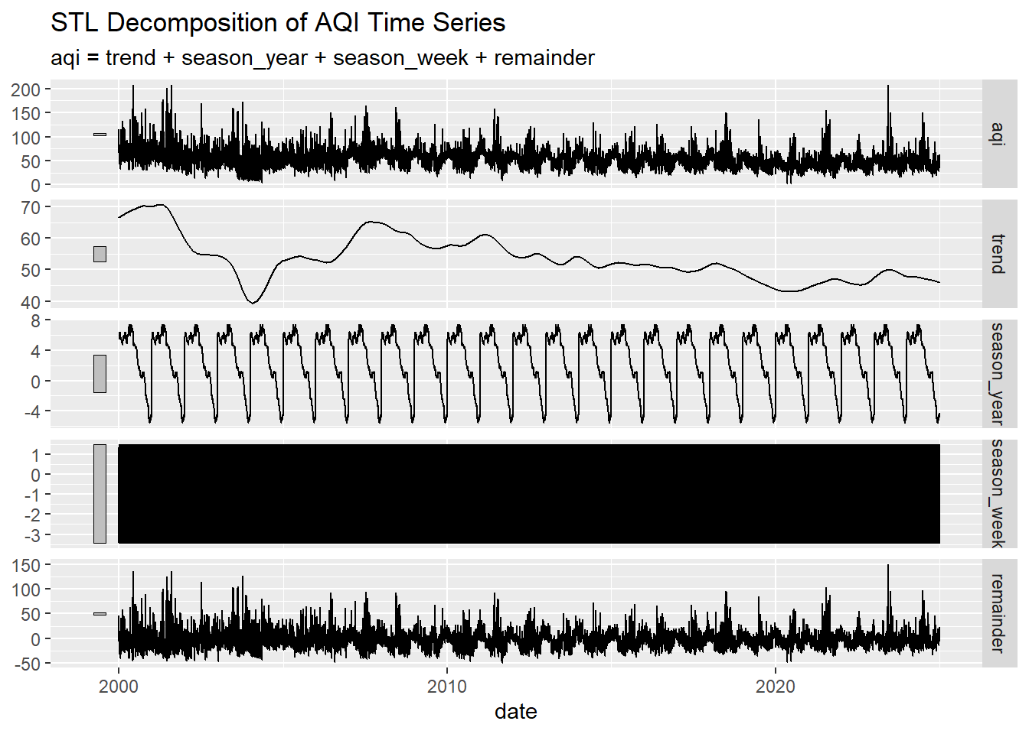
STL Decomposition of AQI Time Series
Trend
The trend is smoother and shows more distinct patterns of rise and fall, indicating that STL decomposition captures long-term trends more effectively.
Seasonality
Two clear seasonal patterns are observed: an annual (season_year) and a weekly (season_week) cycle, suggesting AQI levels are influenced by both yearly and weekly factors.
Random Noise
The remainder, representing random noise, still shows variability but is more refined, suggesting STL decomposition isolates noise more efficiently.

Slide 11
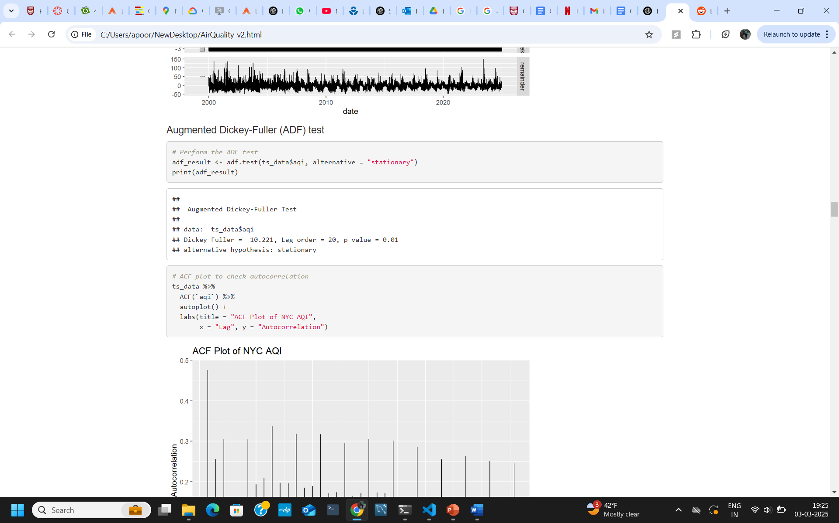
Stationarity
p-value (0.01) < 0.05
Since the p-value is less than the common significance level of 0.05, we reject the null hypothesis (which states that the series is non-stationary). This suggests that the AQI time series is stationary.
Test Statistic (-10.221)
A large negative test statistic further supports the rejection of the null hypothesis.
The AQI time series appears to be stationary, meaning its statistical properties such as mean, variance, and autocorrelation are consistent over time.

Slide 12
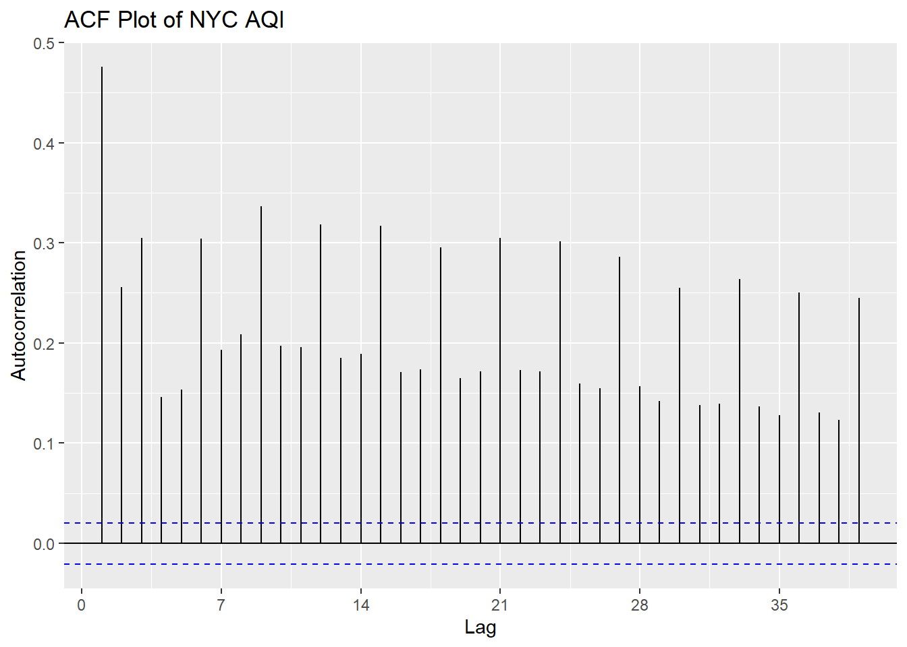
Autocorrelation Plot
Significant Lagged Correlations
The ACF plot shows significant spikes at multiple lags. This suggests that past AQI values have a notable influence on current values, indicating persistence or memory in the series.
Potential Seasonality
Repeated spikes every 3 days are present. This means 3-day cycle/seasonality is present.
Slow Decay in ACF
The gradual decline in autocorrelation indicates that the time series may not be stationary or might require differencing to stabilize its mean.
Data is non-stationary despite the ADF test since it does not take into account strong trend and seasonal patterns.

Slide 13
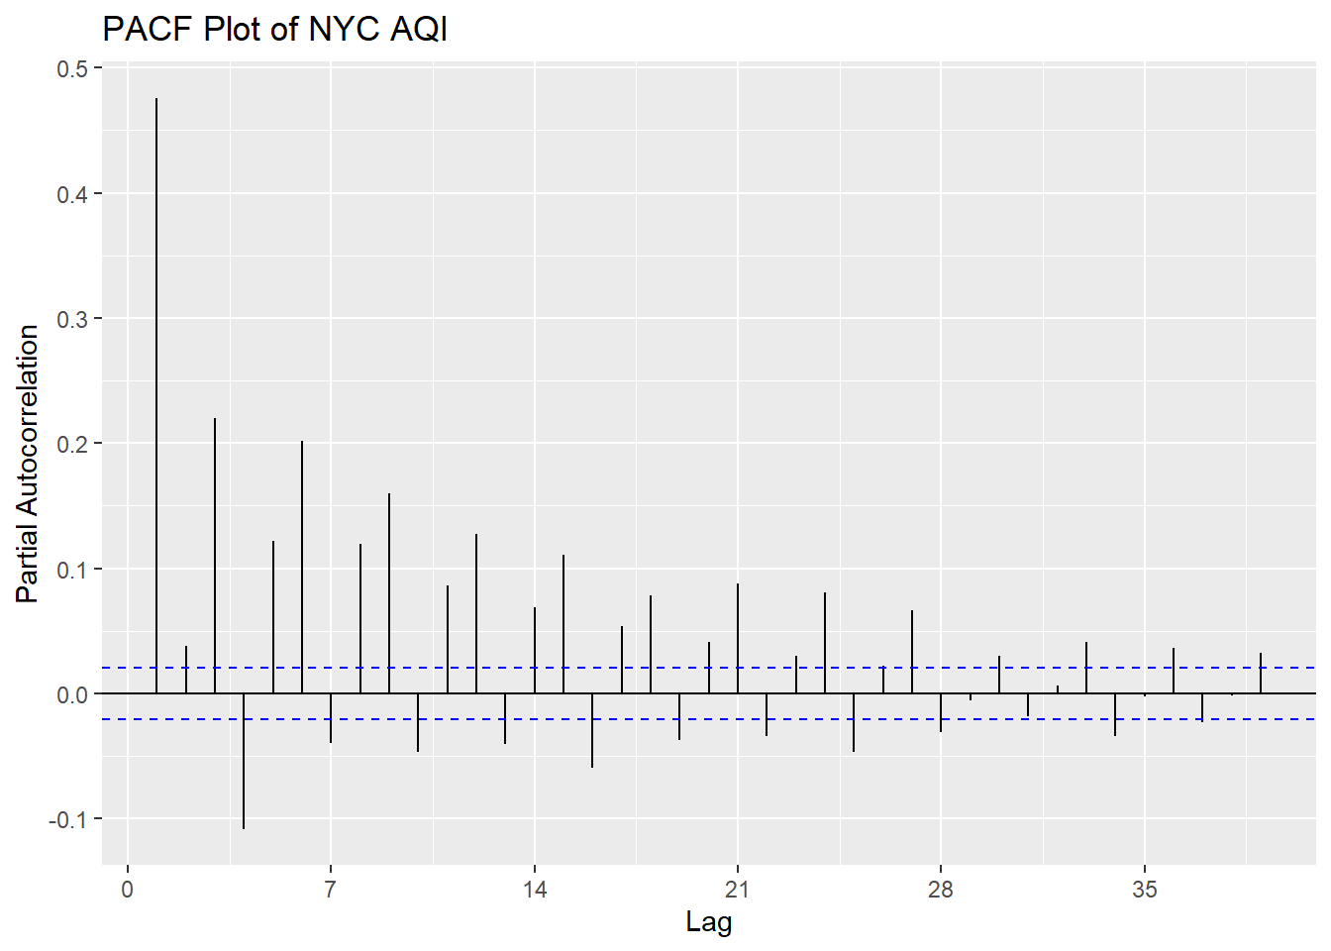
Partial Autocorrelation Plot
High PACF at Lag 1
The strong spike at lag 1 indicates that AQI today is strongly correlated with AQI yesterday, suggesting an Autoregressive Process AR(1) component.
Spikes every 3 days
The noticeable spikes at multiples of 3 lags suggest a 3-day seasonality pattern in the AQI data.
Sharp Cutoff after Lag 1
A rapid decline in PACF after lag 1 supports the presence of a low-order AR process, implying that most of the autocorrelation can be explained by a small number of past values.

Slide 14
Hyperparameter Tuning
Hyperparameter Selection | Rationale
Trend: Non-Seasonal Differencing (d = 1) | The “NYC Air Quality Index (AQI) Over Time” plot shows a slightly decreasing trend, indicating non-constant mean and variance. Differencing is needed to make the series stationary.
Seasonality: Seasonal Differencing (D = 1, S = 3) | The presence of periodic patterns in both the time series plot and the “Seasonal Trend Decomposition for AQI” plot suggests a seasonal component with a 3-day cycle.
ACF: Moving Average Terms (q = 1, Q = 1) | Repeated spikes every 3 days and a gradual decline in ACF suggest a seasonal MA term at lag 3 and a non-seasonal MA term of order 1 to capture short-term dependencies.
PACF: Autoregressive Terms (p = 1, P = 1) | High PACF at lag 1 and spikes every 3 days suggest a non-seasonal AR(1) process and a seasonal AR term of order 1 at lag 3 to capture the autocorrelations observed.

Slide 15
Time Series Forecasting Model Selection

Slide 16
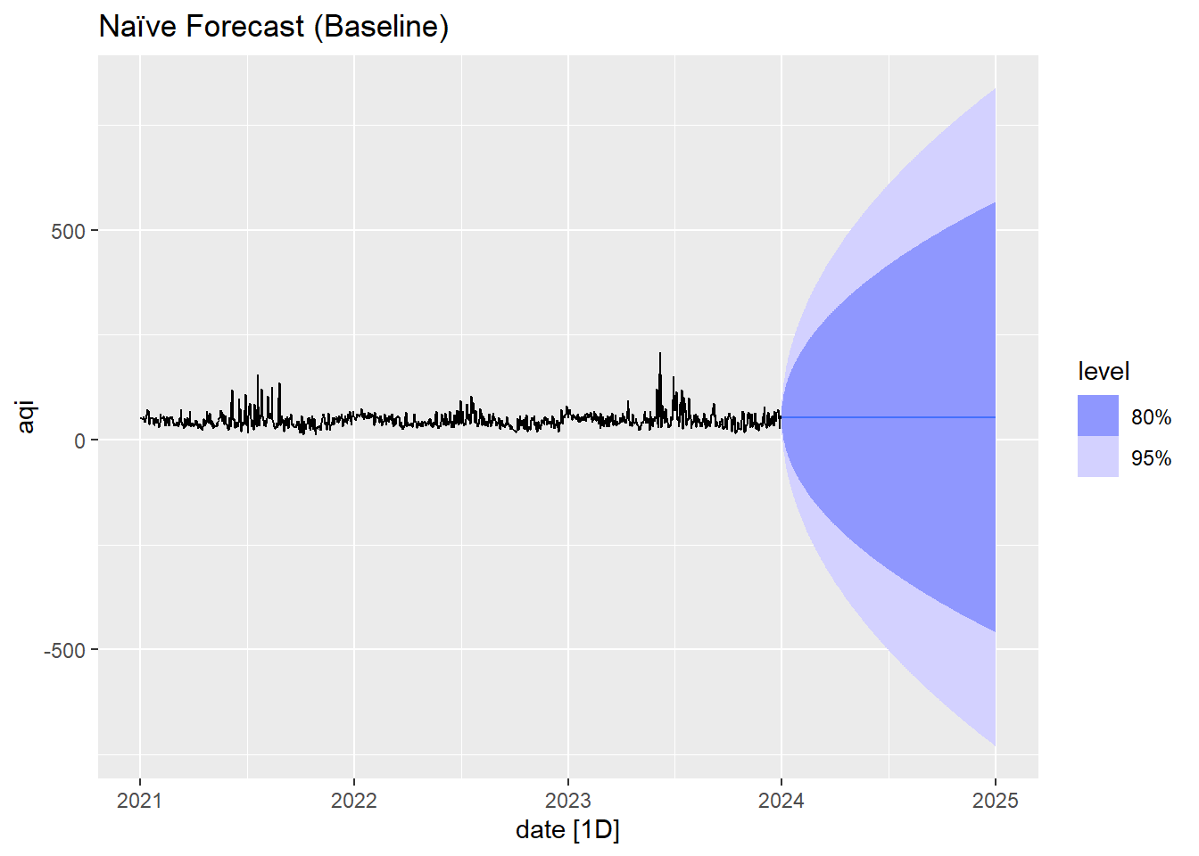
Naïve Forecast (Baseline)
No Trend The Naive model does not capture any trend component, implying it assumes the AQI value remains constant as the last observed value.
No Seasonality The model fails to capture any seasonal patterns, suggesting it cannot handle periodic variations in AQI.
Weak Baseline Model As expected, the Naive model serves as a very basic benchmark, useful only for comparison. Real AQI data has evident seasonality and trends, making this model insufficient for accurate forecasting.
Variance (σ² = 437.5424) The high variance suggests that the model's predictions are widely spread around the mean, indicating high uncertainty in forecasts.

Slide 17
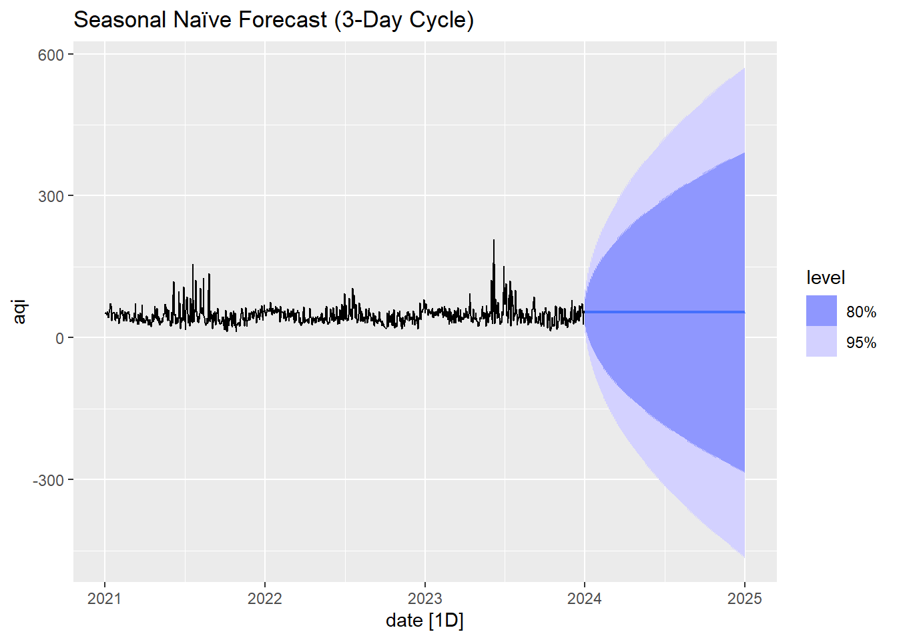
Seasonal Naïve Forecast (Baseline)
No Trend Similar to the Naive model, the Snaive model does not capture any trend, assuming AQI values repeat based on the last seasonal cycle.
Short-term Seasonality The Snaive model accounts for short-term seasonal patterns by repeating the last observed seasonal values, providing a better fit than the Naive model.
Improves Naive Model but Still Too Simple While it performs better than the Naive model due to its ability to handle short-term seasonality, it is still too basic for real AQI data, which exhibits more complex trends and seasonal patterns.
Higher Variance (σ² = 571.5659) The higher variance compared to the Naive model suggests that the Snaive model's forecasts are even more dispersed, indicating limitations in capturing underlying patterns effectively.

Slide 18
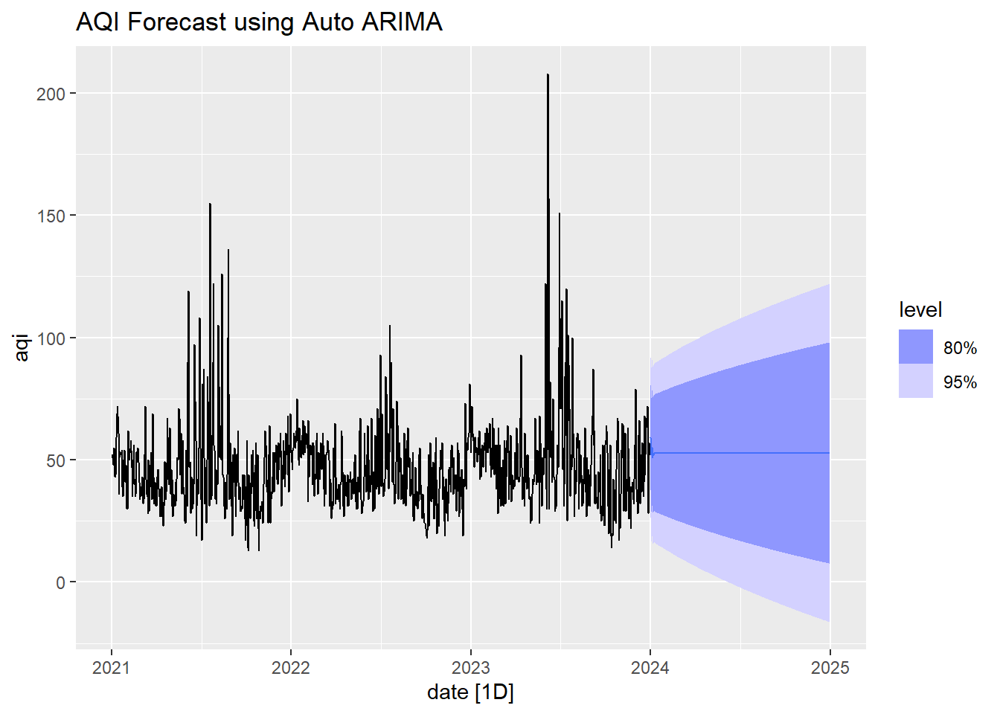
ARIMA Forecast
Model Structure and Seasonality The ARIMA(4,1,1)(0,0,1)[7] model effectively captures both short-term dependencies and seasonal patterns, with a 7-period seasonal cycle indicating weekly trends in the data.
AR and MA Coefficients The AR coefficients show mixed relationships with past values (positive for ar1 and ar3, negative for ar2 and ar4), while the MA coefficients (ma1 = -0.9043, sma1 = -0.0830) suggest significant impacts from past errors and seasonal fluctuations.
Residual Variance The estimated residual variance (σ² = 278.9) indicates a moderate level of error, suggesting the model fits the data reasonably well but may still have room for improvement.
Model Fit (AIC and BIC) The AIC (74239.23) and BIC (74288.78) values suggest that the model is relatively well-fitted, with AIC indicating it is a good candidate when compared to other models.

Slide 19
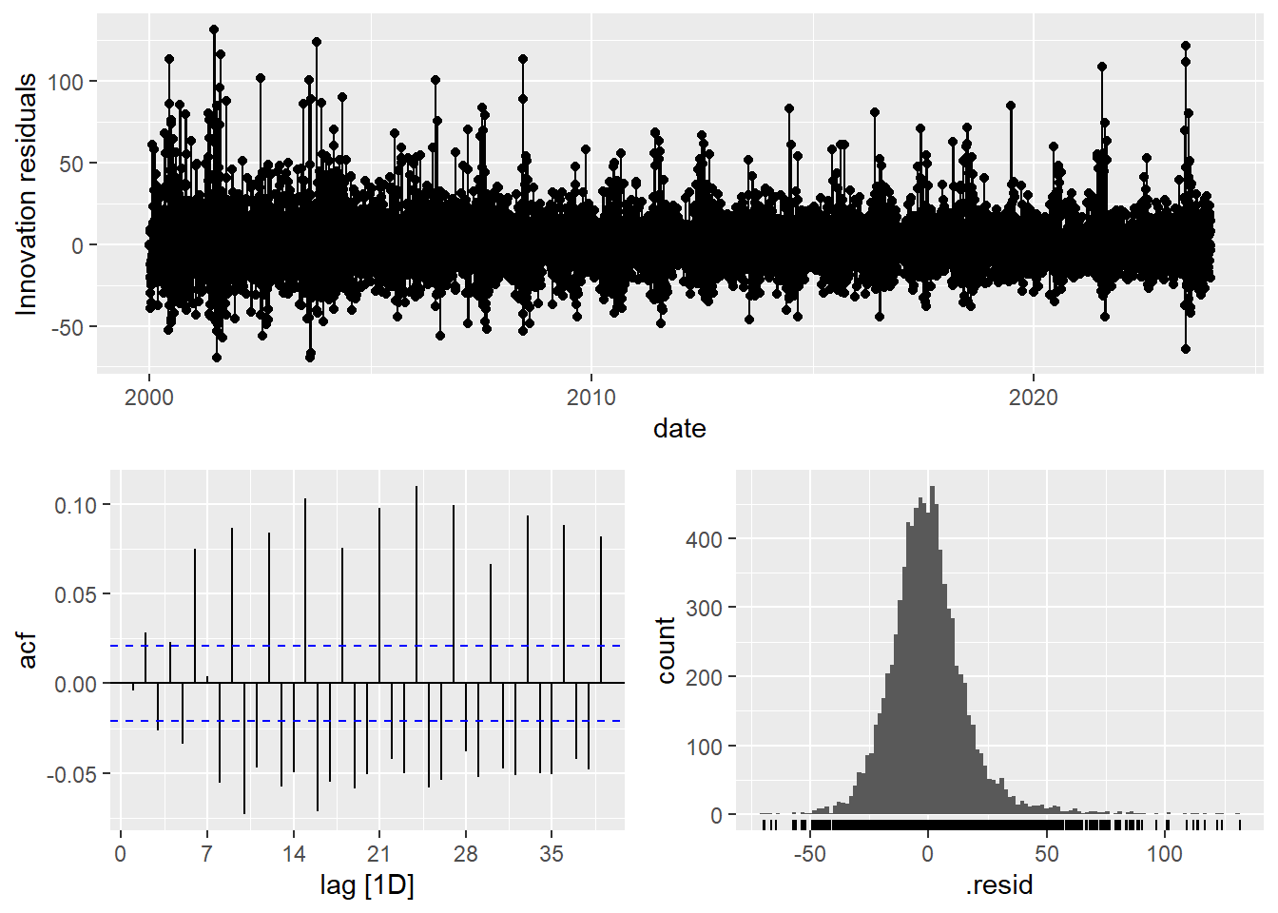
ARIMA model residual plots
Residuals over Time Plot
Residuals are centered around zero with significant variability, indicating potential non-stationarity, outliers, or heteroscedasticity.
ACF Plot
Many of the autocorrelation values are outside the blue significance bounds, indicating that the residuals are not white noise, suggesting possible seasonality, missing exogenous factors, or model misspecification.
Histogram of Residuals
The distribution is roughly centered but has long tails, indicating deviations from normality.

Slide 20
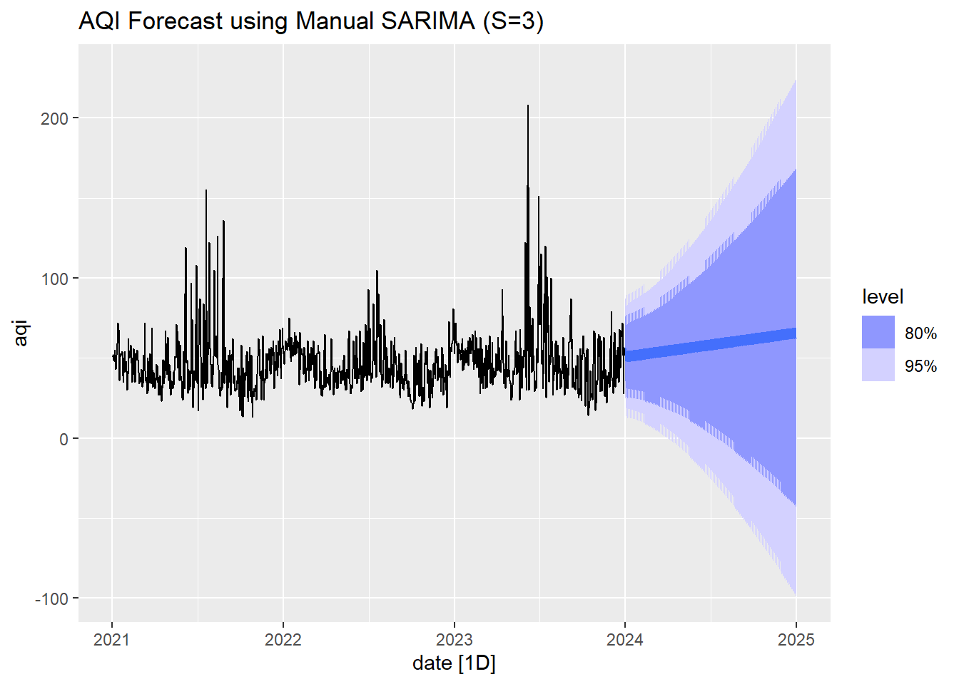
SARIMA Forecast
Model Structure and Seasonality The SARIMA(1,1,1)(1,1,1)[3] model accounts for both short-term and seasonal dependencies, with a 3-period seasonal cycle capturing quarterly trends in the data.
AR and MA Coefficients The AR coefficient (ar1 = 0.4209) and MA coefficient (ma1 = -0.9618) indicate significant relationships with past values and errors, while the seasonal AR (sar1 = -0.0364) and seasonal MA (sma1 = -0.9580) coefficients show notable impacts from past seasonal errors.
Residual Variance The estimated residual variance (σ² = 252.5) is lower compared to the previous model, suggesting that this SARIMA model provides a relatively better fit with fewer errors.
Model Fit (AIC and BIC) The AIC value of 73351.47 and BIC of 73386.86 suggest that the SARIMA model offers a better fit than the previous ARIMA model, making it a strong candidate for forecasting.

Slide 21
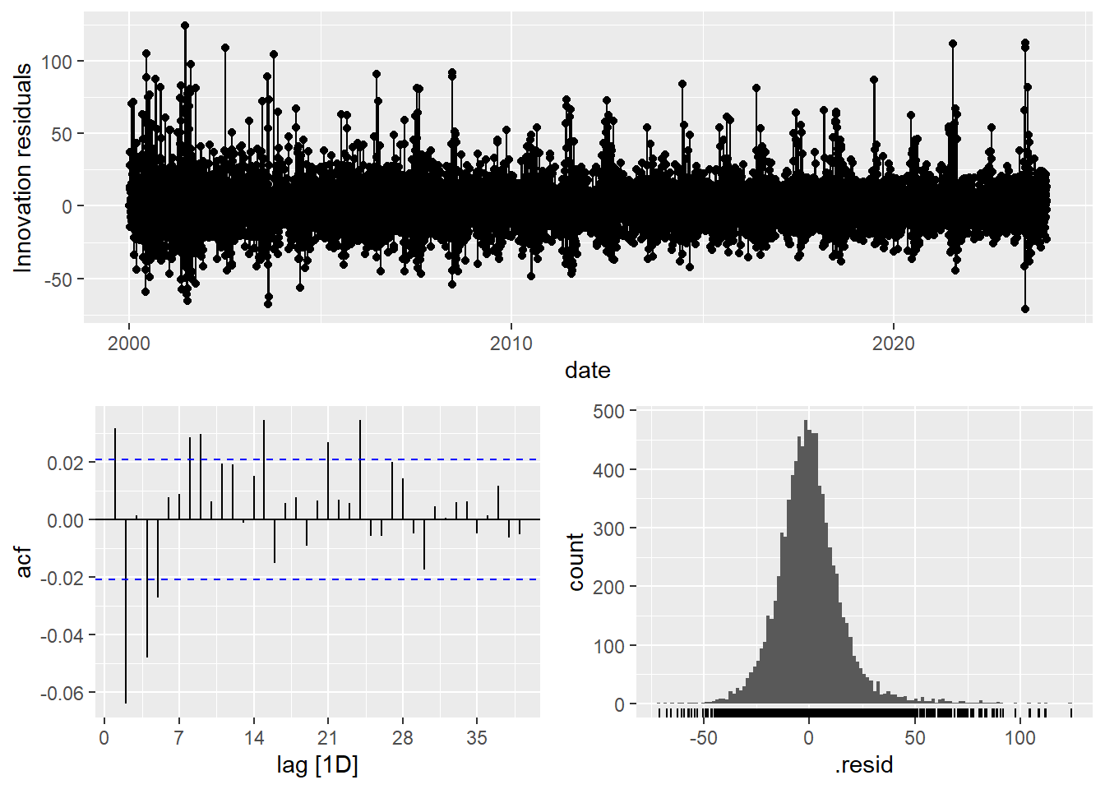
SARIMA model residual plots
Residuals over Time Plot
Residuals are centered around zero with significant variability, indicating potential non-stationarity, outliers, or heteroscedasticity.
ACF Plot
The spikes outside the blue bounds in the ACF suggest potential missing seasonal effects or exogenous factors (e.g., weather, traffic data).
Histogram of Residuals
The distribution is roughly centered but has long tails, indicating deviations from normality.
Trying SARIMAX (SARIMA + exogenous variables) model to account for other AQI influences.

Slide 22
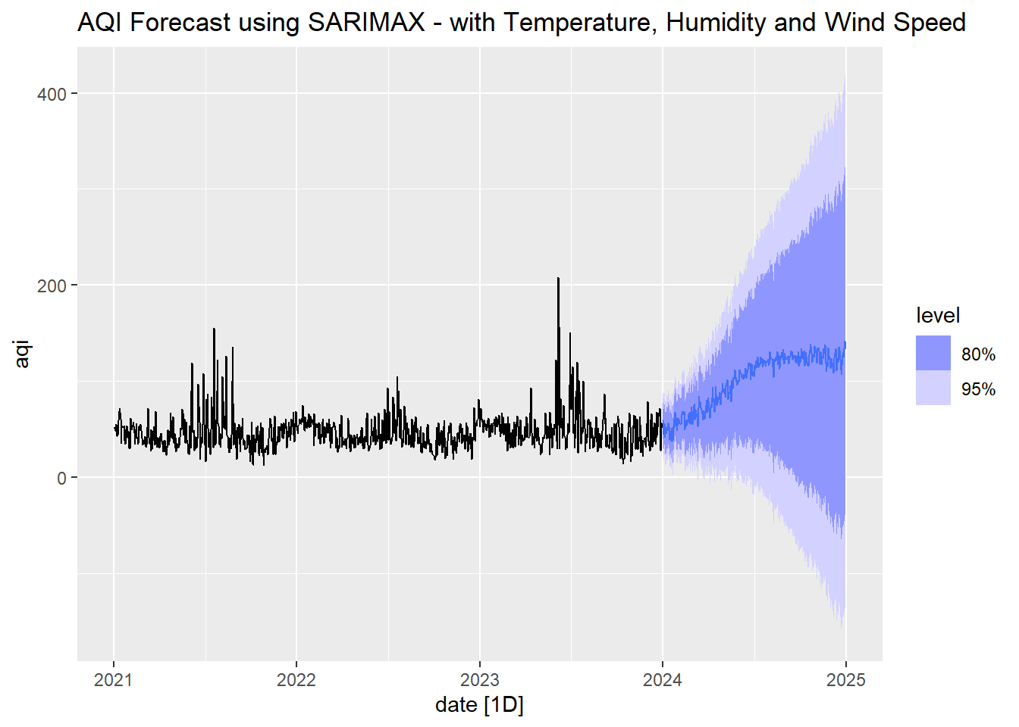
SARIMAX Forecast
Model Structure and Seasonality
The SARIMA(1,1,1)(1,1,1)[3] model accounts for both short-term and seasonal dependencies, with a 3-period seasonal cycle capturing quarterly trends in the AQI data.
AR and MA Coefficients
The AR coefficient (ar1 = 0.3513) and MA coefficient (ma1 = -0.9339) indicate significant relationships with past values and errors. The seasonal AR (sar1 = -0.0369) and seasonal MA (sma1 = -0.9429) coefficients also demonstrate notable impacts from past seasonal errors.
Explanatory Variables
The model includes external variables such as average temperature (0.6035), average humidity (-0.0397), and average wind speed (-1.2589), highlighting how these factors influence AQI. The positive coefficient for temperature suggests a direct relationship with AQI, while the negative coefficients for humidity and wind speed indicate inverse relationships.
Residual Variance
The estimated residual variance (σ² = 214.4) indicates the model’s error level. The lower variance compared to previous models suggests a better fit with fewer errors.
Model Fit (AIC and BIC)
The AIC value of 71916.71 and BIC of 71973.33 suggest a strong model fit. These metrics are lower than previous models, reinforcing the model’s suitability for forecasting AQI effectively.

Slide 23

SARIMAX model residual plots
Residuals over Time Plot
Residuals are centered around zero with reduced variability compared to previous models, suggesting improved fit but still potential outliers or heteroscedasticity.
ACF Plot
Fewer significant spikes in the ACF indicate that the SARIMAX model has better captured temporal dependencies, but some autocorrelation remains, suggesting further refinement may be needed.
Histogram of Residuals
The residuals are roughly centered with a sharper peak and fewer long tails, indicating a closer approximation to normality.

Slide 24
Model Selection
Naïve Snaïve ARIMA SARIMA SARIMAX
ME -0.00707 -0.0181 -0.0400 0.0500 0.0465
RMSE 20.9 23.9 16.7 15.9 14.6
MAE 14.5 16.7 12.0 11.3 10.3
MASE 0.791 0.907 0.652 0.616 0.563
AIC -- -- 74239 73351 71917
BIC -- -- 74289 73387 71973
Lowest RMSE (14.63), indicating superior predictive accuracy
Lowest MAE (10.32), reflecting minimal average forecasting error
MASE of 0.56, it outperforms naïve benchmark models (<1)
Minimal mean error (0.046) suggests lower bias in predictions
Lowest AIC, signifying a better model fit and higher accuracy
Lowest BIC, ensuring reduced complexity by penalizing extra parameters effectively
SARIMAX is the best model

Slide 25
How do weather conditions affect AQI?

Slide 26
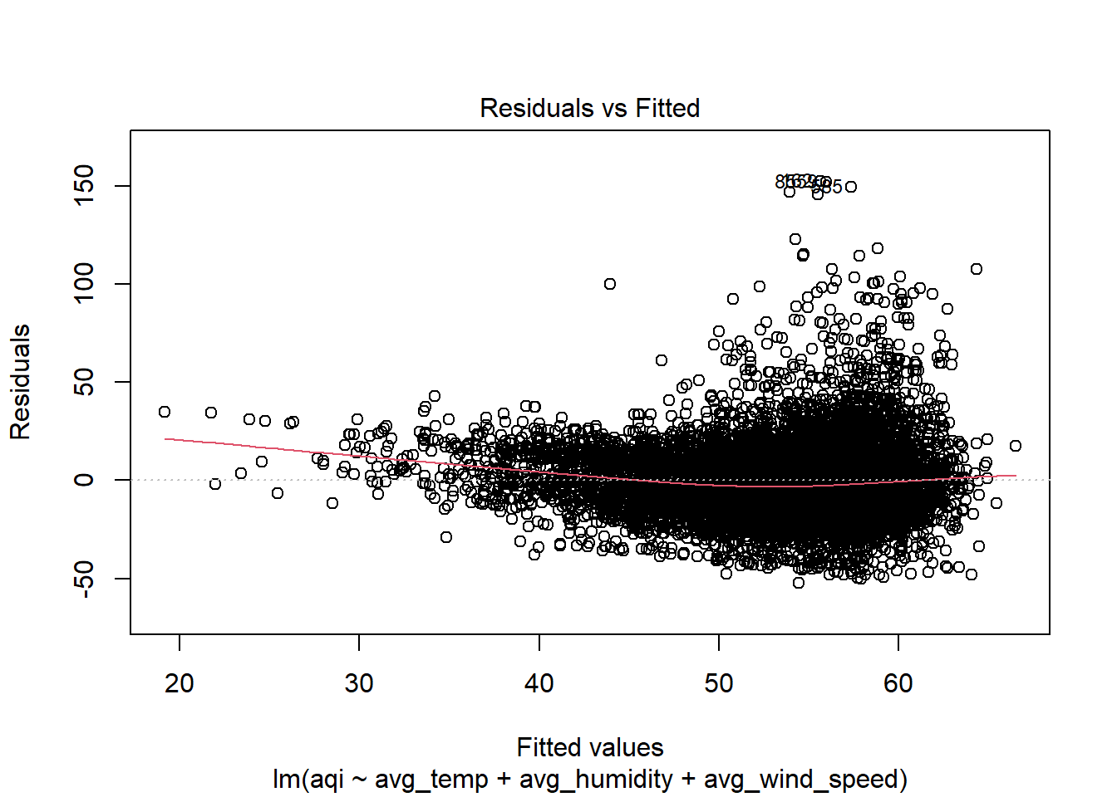
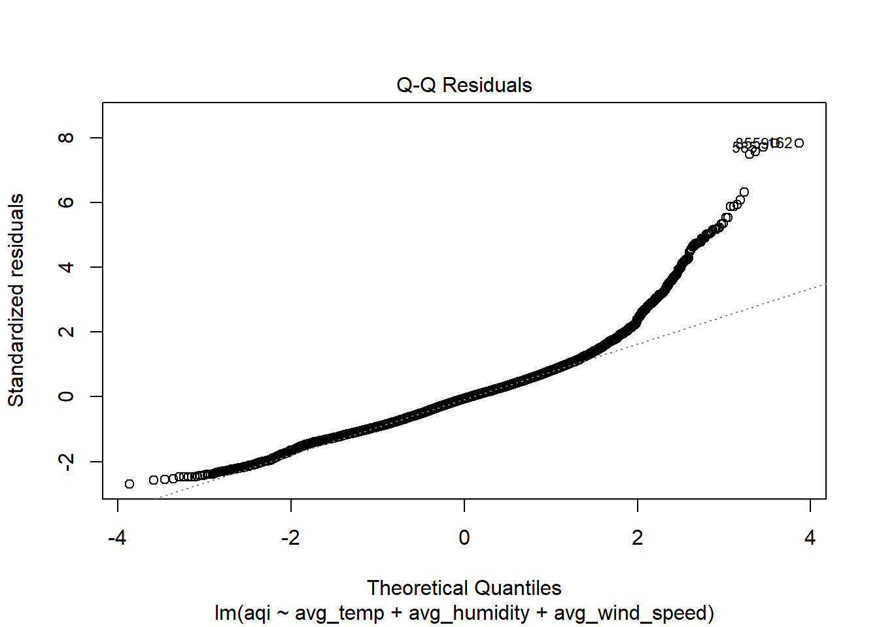
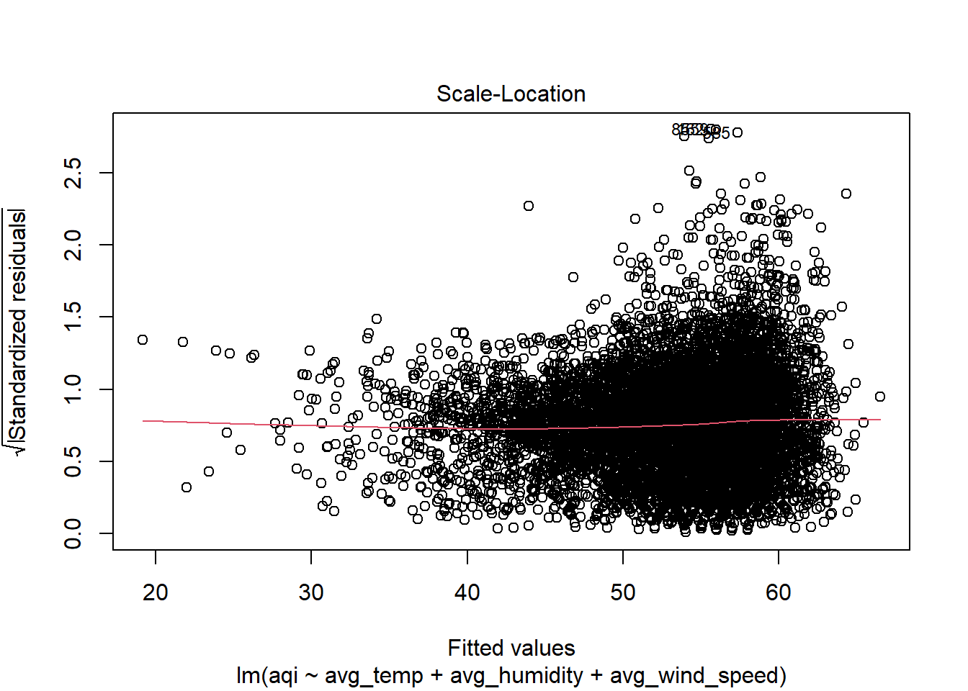
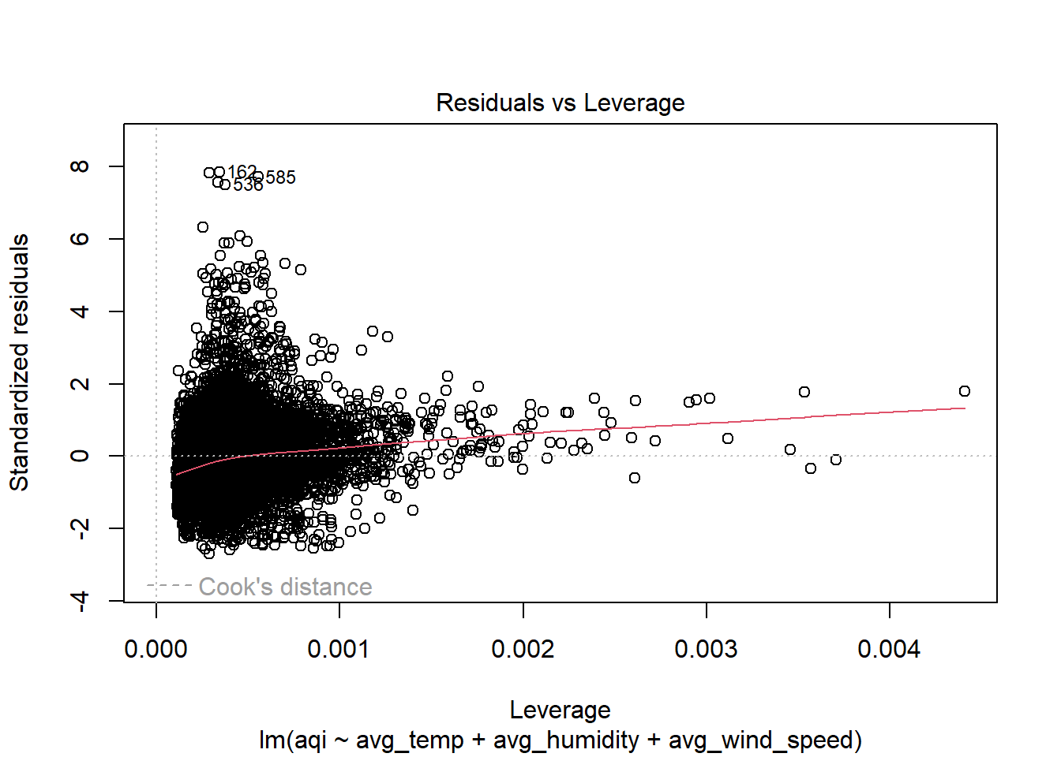
SARIMAX model residual plots
Linear Regression Residual Plots
CORRELATION MATRIX | AQI | TEMP | HUMIDITY | WIND SPEED
AQI | NA | 0.0864 | -0.00817 | -0.28
TEMP | 0.0864 | NA | 0.211 | -0.379
HUMIDITY | -0.00817 | 0.211 | NA | -0.122
WIND SPEED | -0.28 | -0.379 | -0.122 | NA
Wind Speed is the most significant predictor (p<2e−16p ): A 1 unit increase in wind speed reduces AQI by 1.41 units, reinforcing the dispersal effect.
Wind Speed has the strongest negative correlation (-0.28) - Higher wind speeds likely help disperse pollutants, reducing AQI levels.
Temperature has a weak positive correlation (0.086) - Warmer temperatures might contribute to higher AQI due to increased chemical reactions forming secondary pollutants (e.g., ozone).
Humidity shows minimal correlation (-0.008) - While humidity can impact certain pollutants (e.g., particulate matter), its overall effect on AQI in this dataset is weak.
Linear Regression Model
AQI=73.22−0.018×Temperature−0.053×Humidity−1.41×Wind Speed

Slide 27
THANK
YOU

